Slide 1

OCH Hackathon Project A

Slide 2
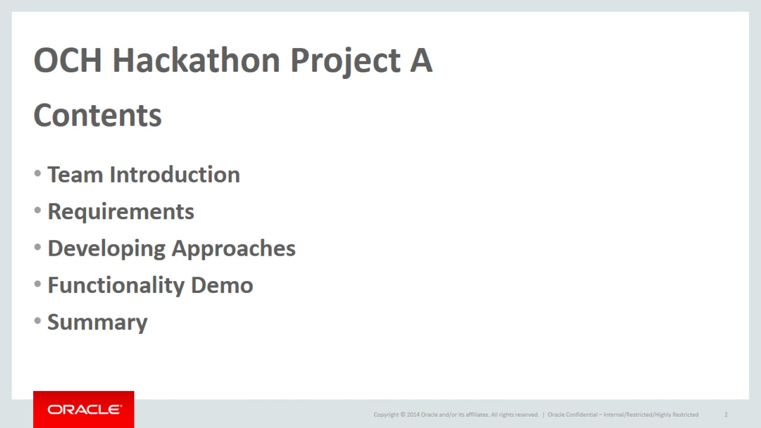
OCH Hackathon Project A

Slide 3
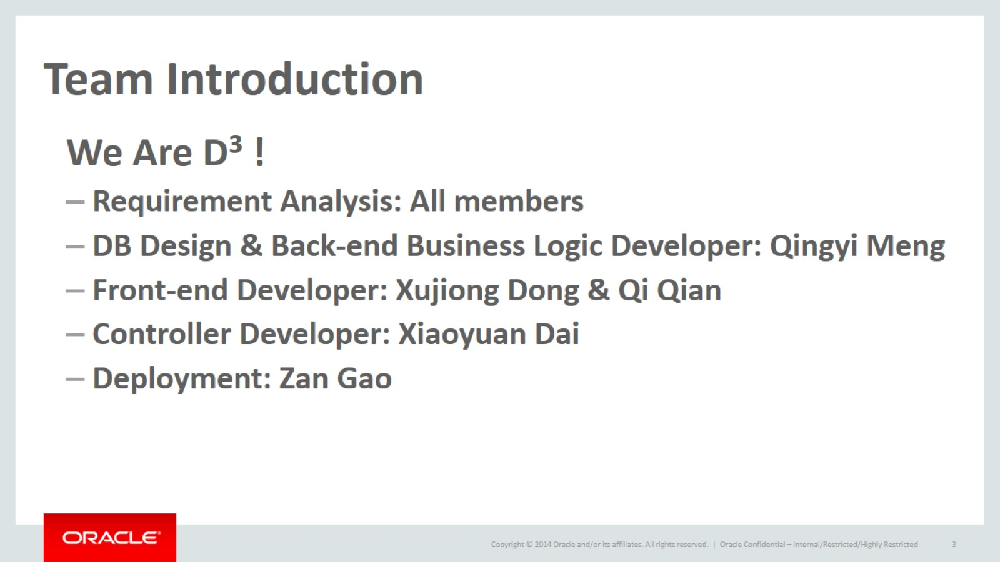
Team Introduction

Slide 4
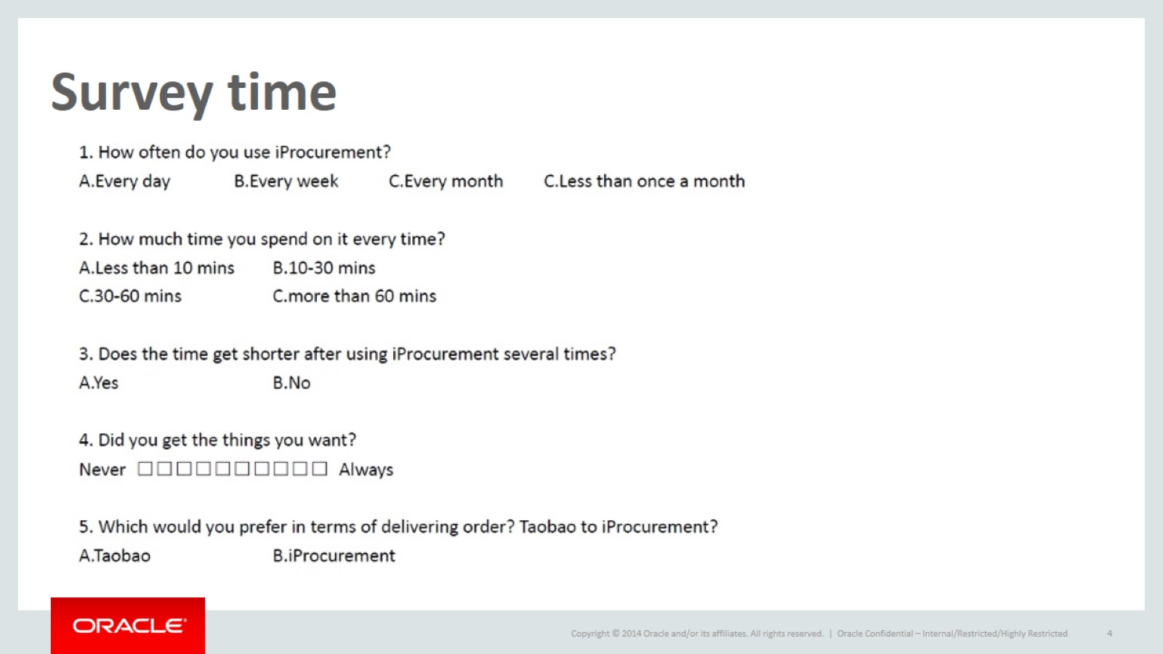
Survey time

Slide 5
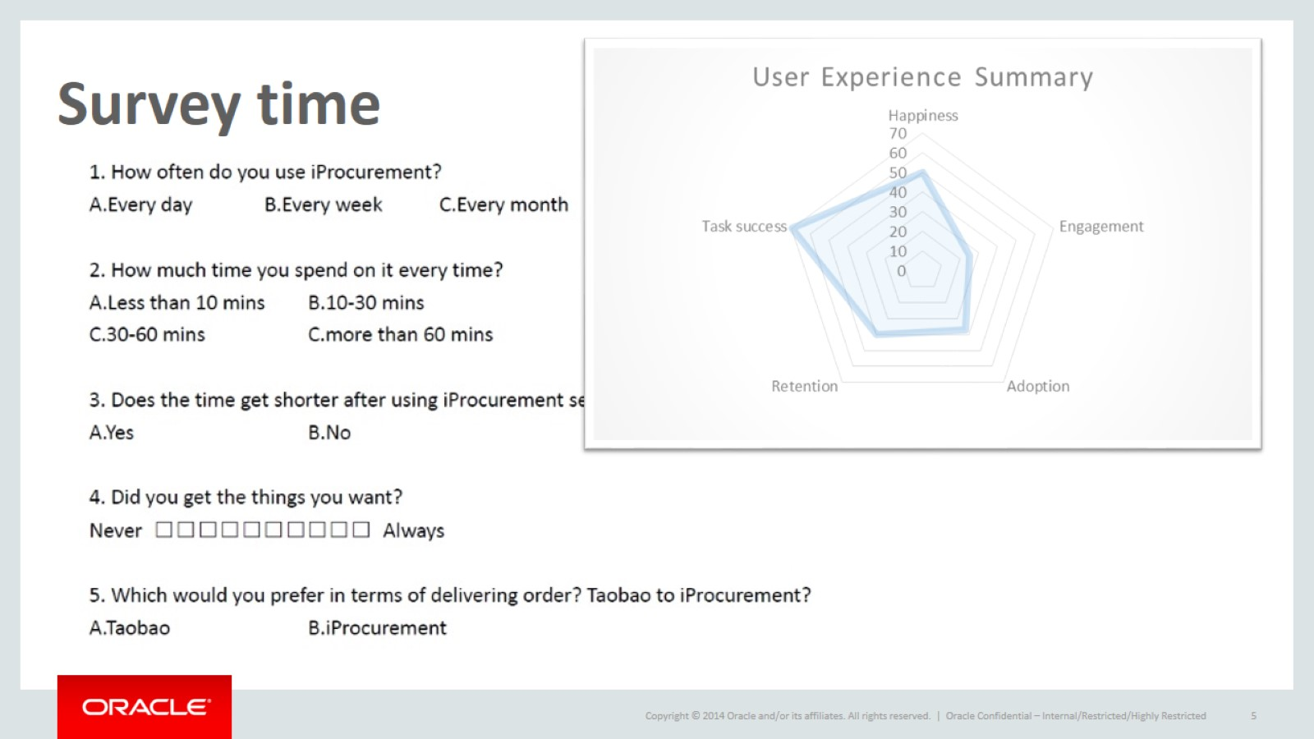
Survey time

Slide 6
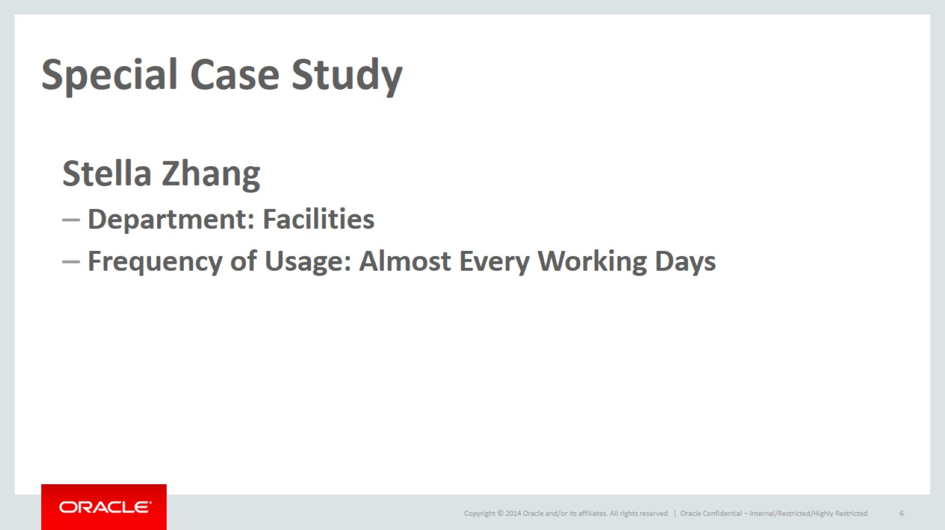
Special Case Study

Slide 7
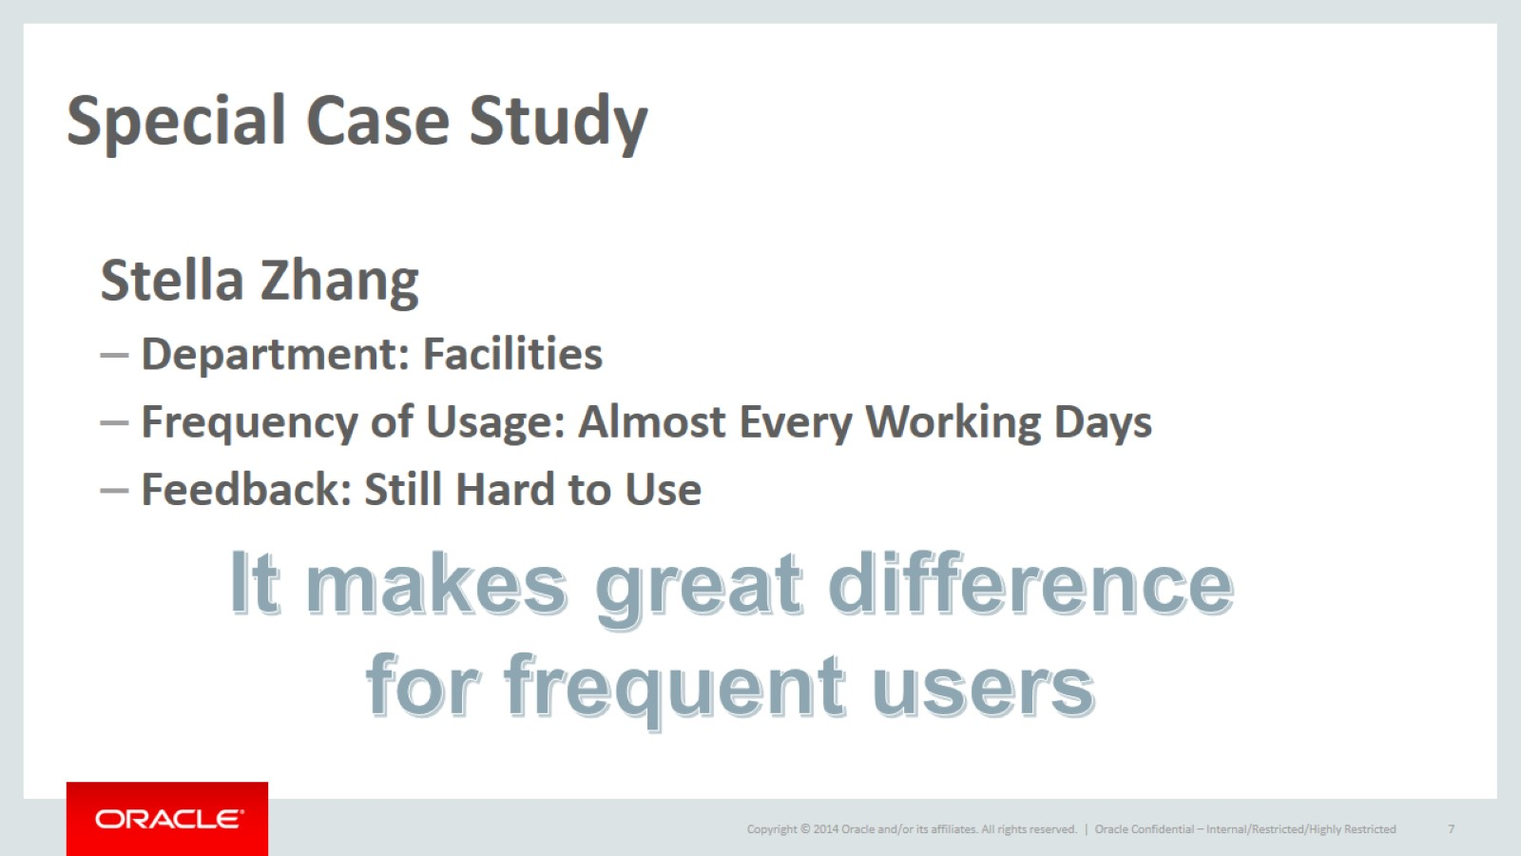
Special Case Study

Slide 8
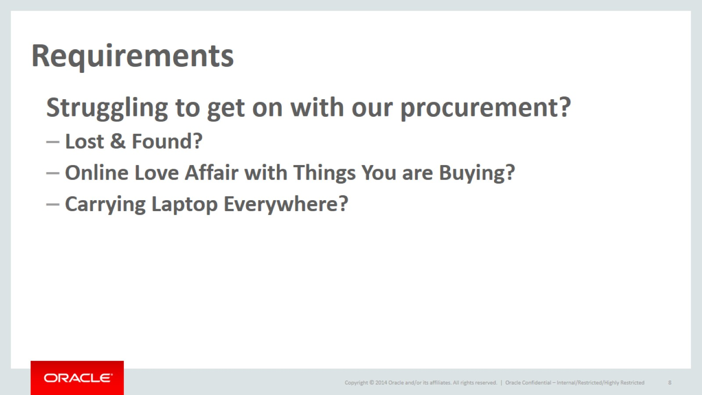
Requirements

Slide 9

Lost & Found?

Slide 10
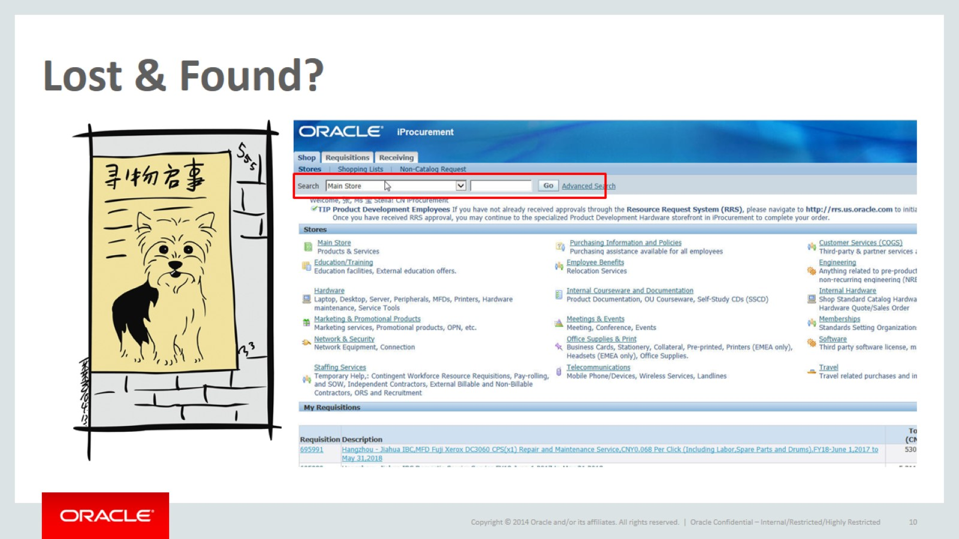
Lost & Found?

Slide 11
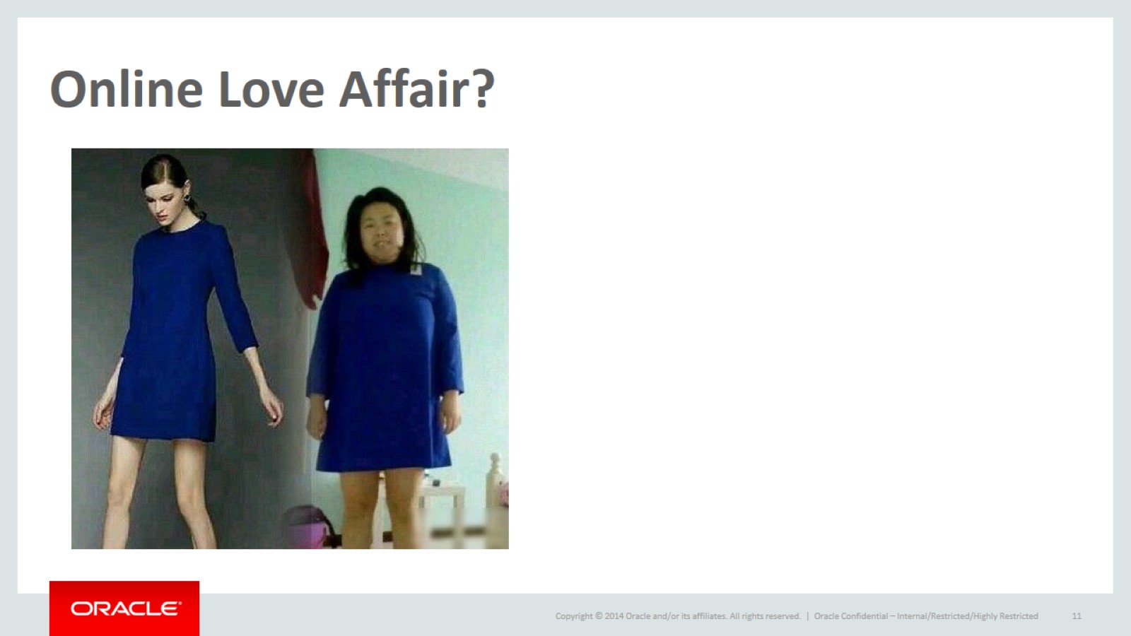
Online Love Affair?

Slide 12
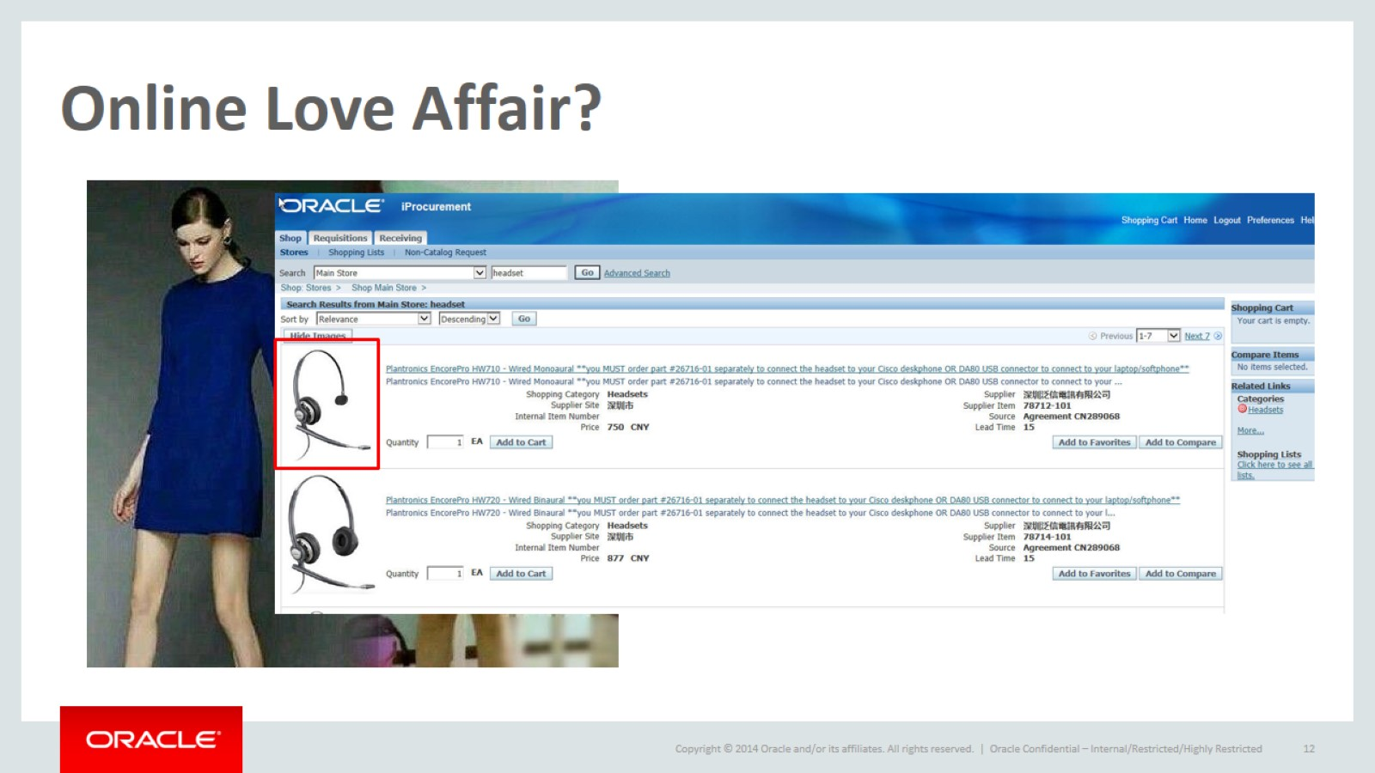
Online Love Affair?

Slide 13
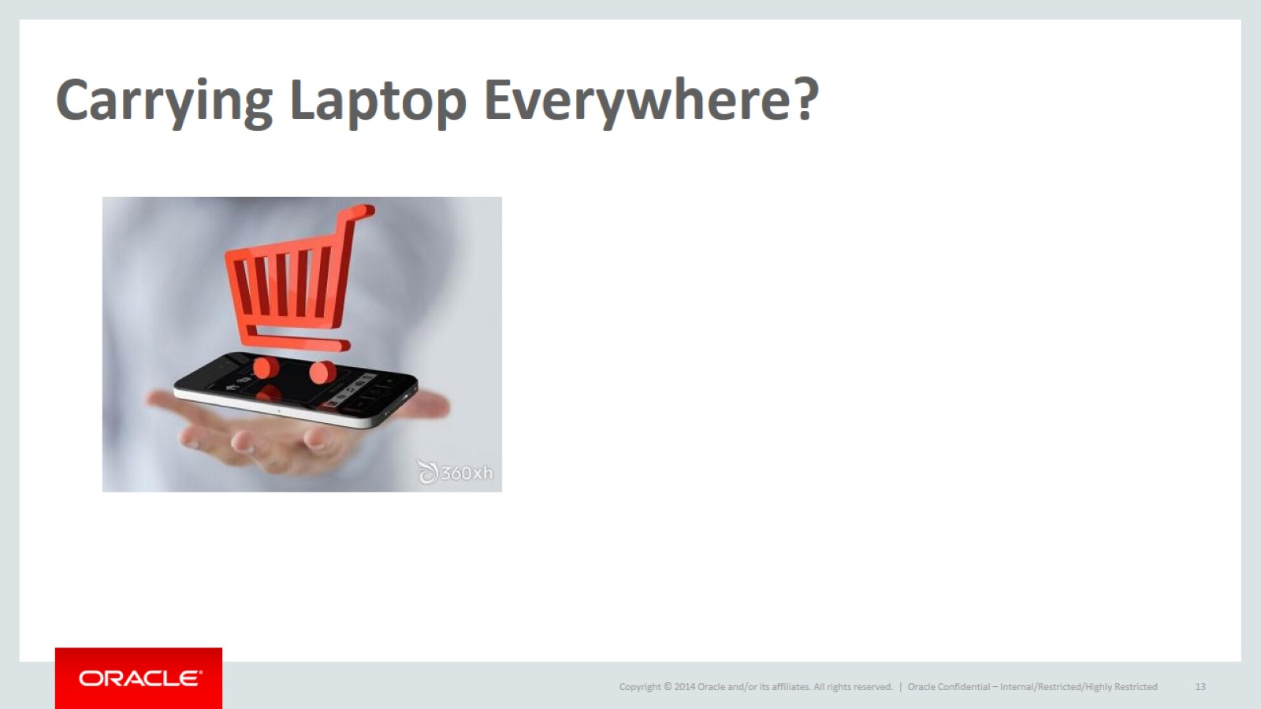
Carrying Laptop Everywhere?

Slide 14
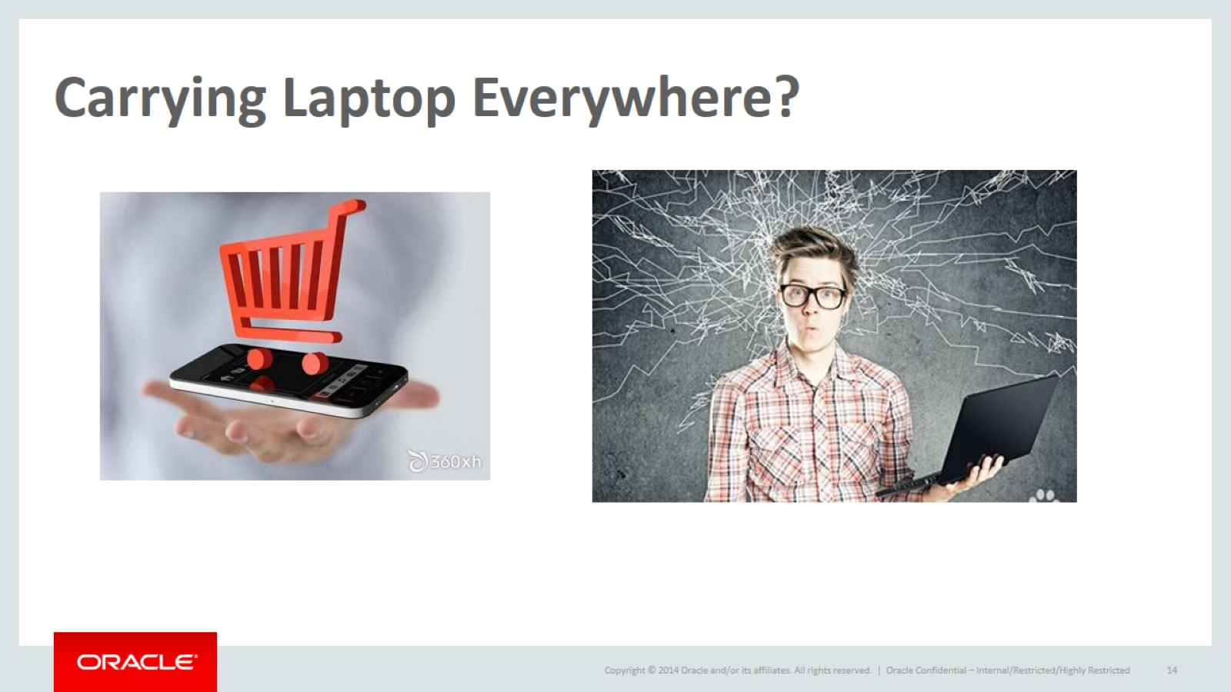
Carrying Laptop Everywhere?

Slide 15
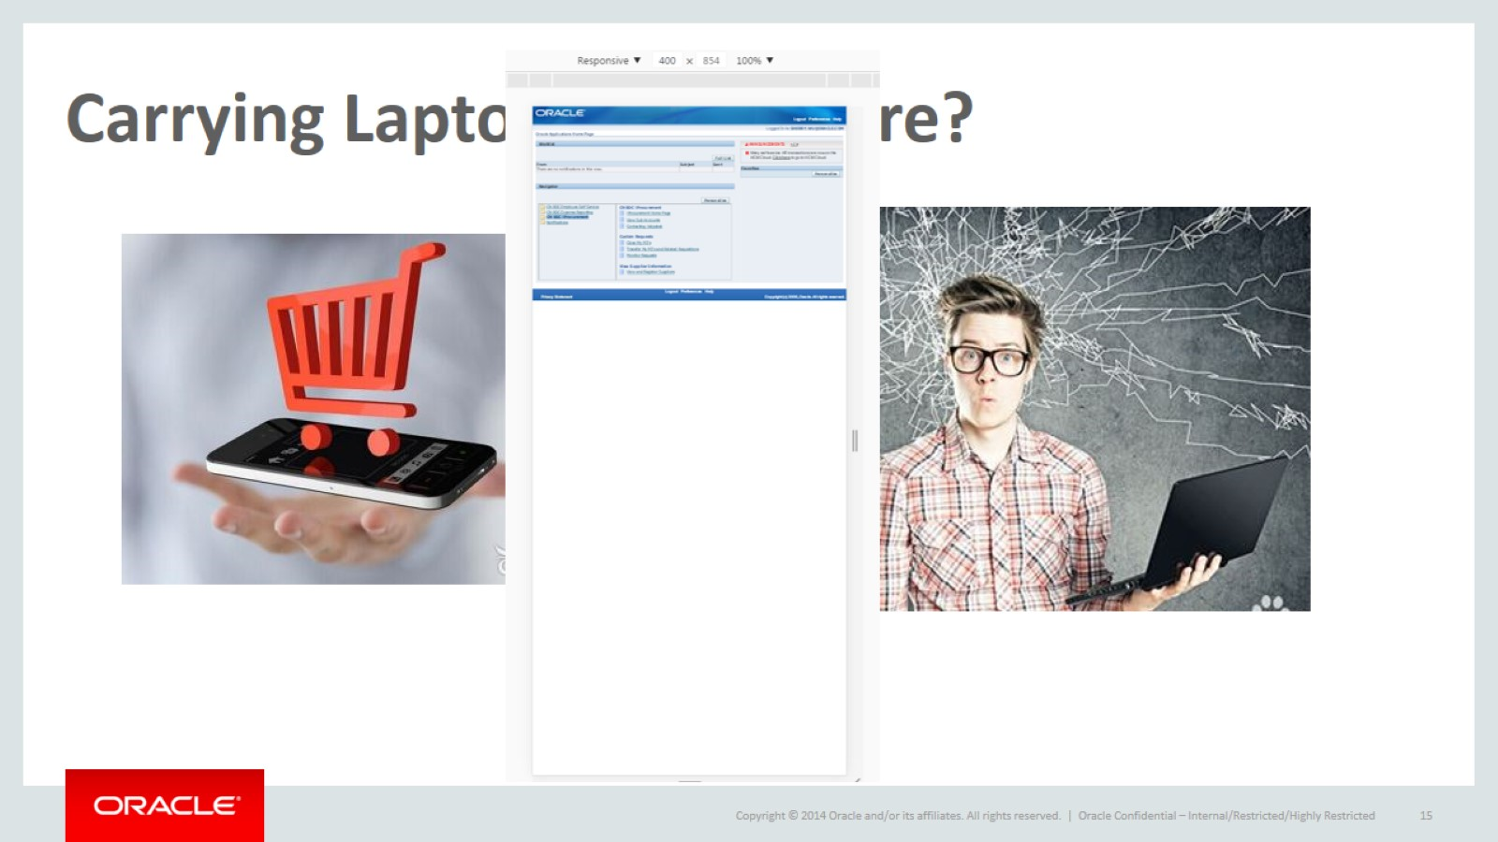
Carrying Laptop Everywhere?

Slide 16
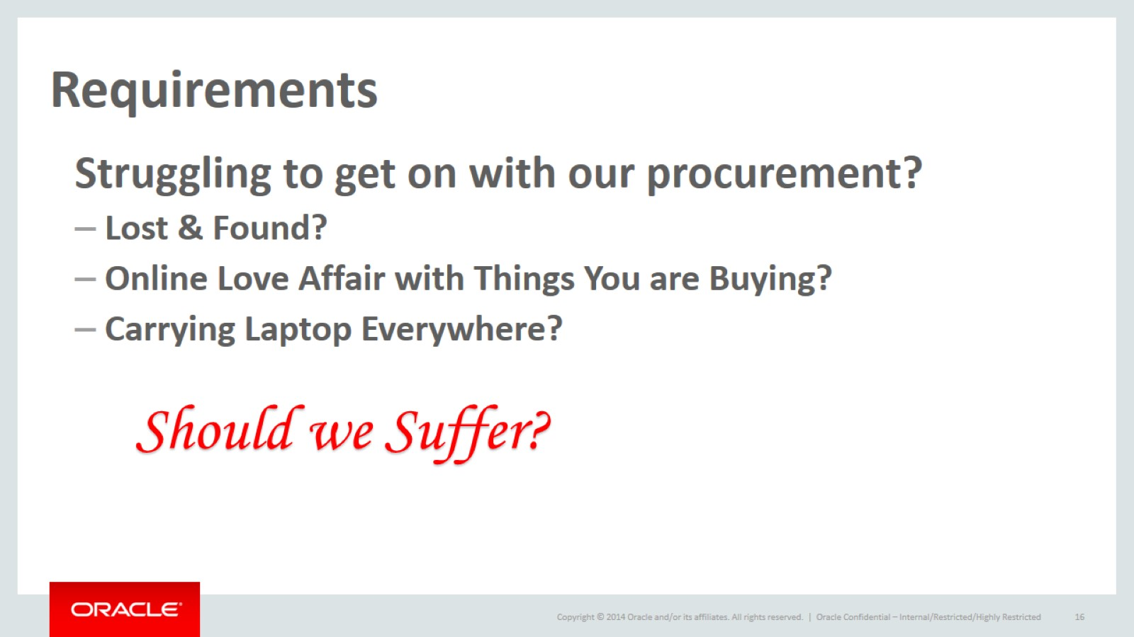
Requirements

Slide 17
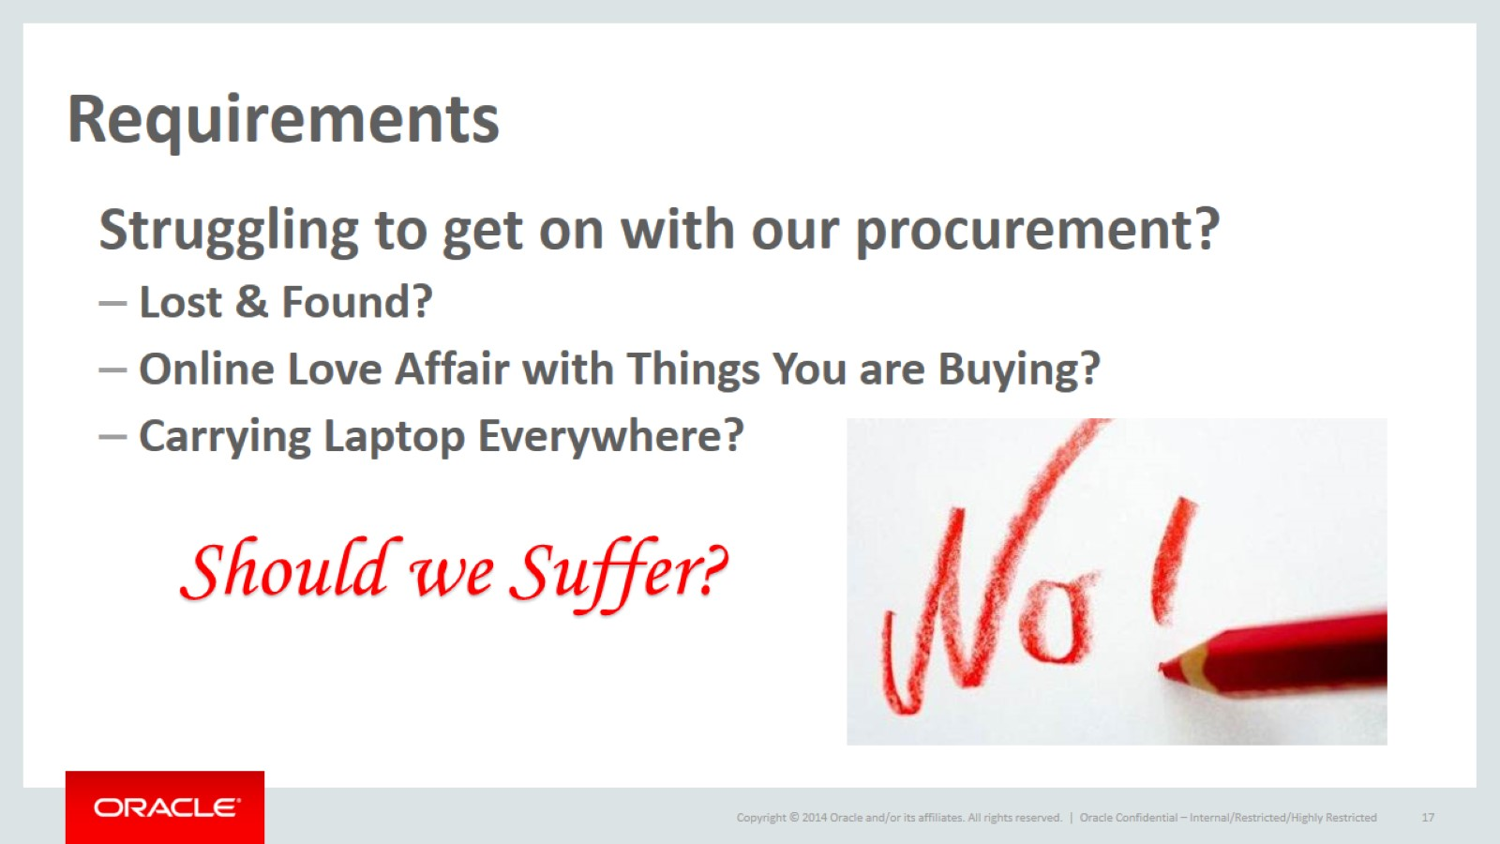
Requirements

Slide 18
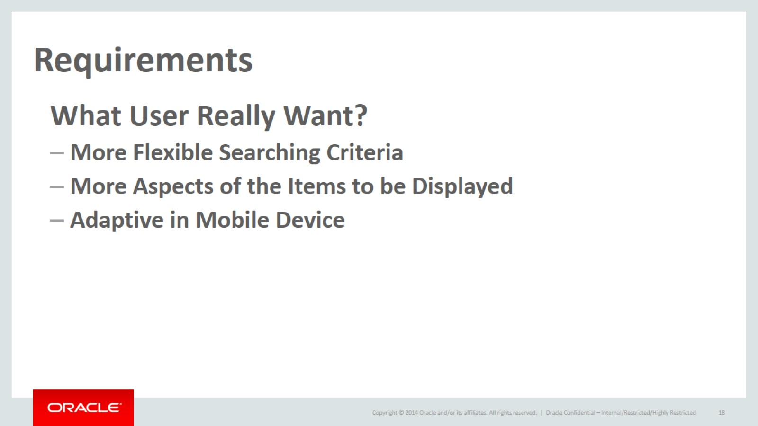
Requirements

Slide 19
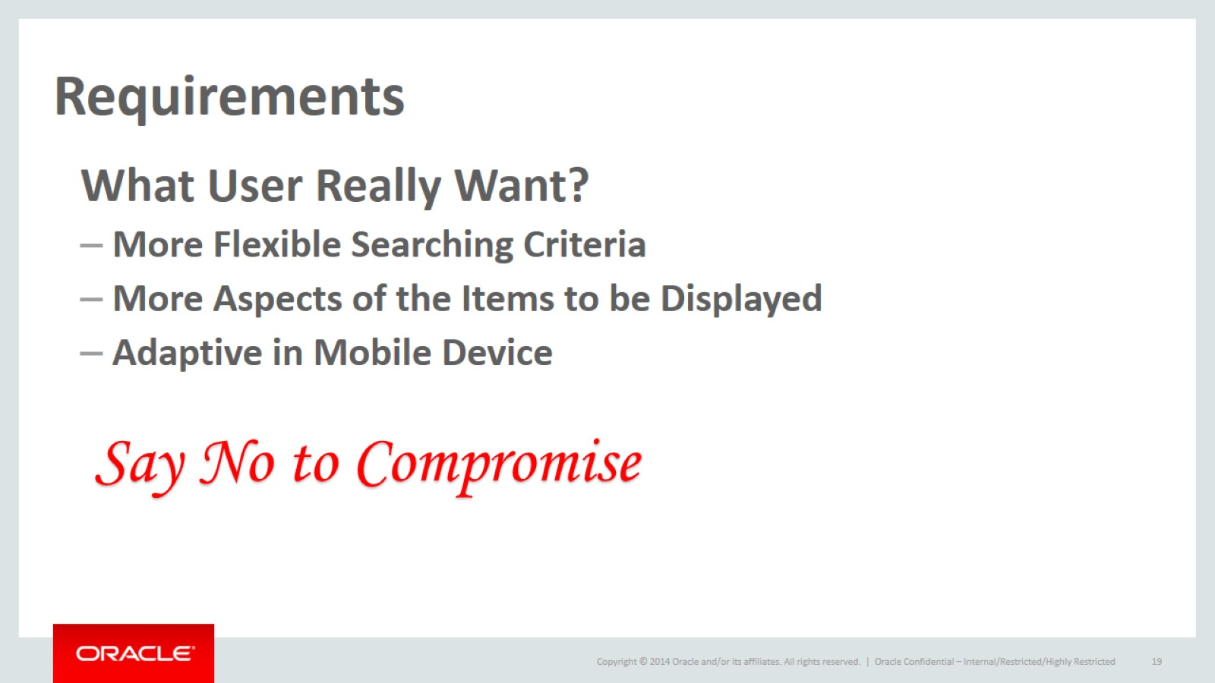
Requirements

Slide 20
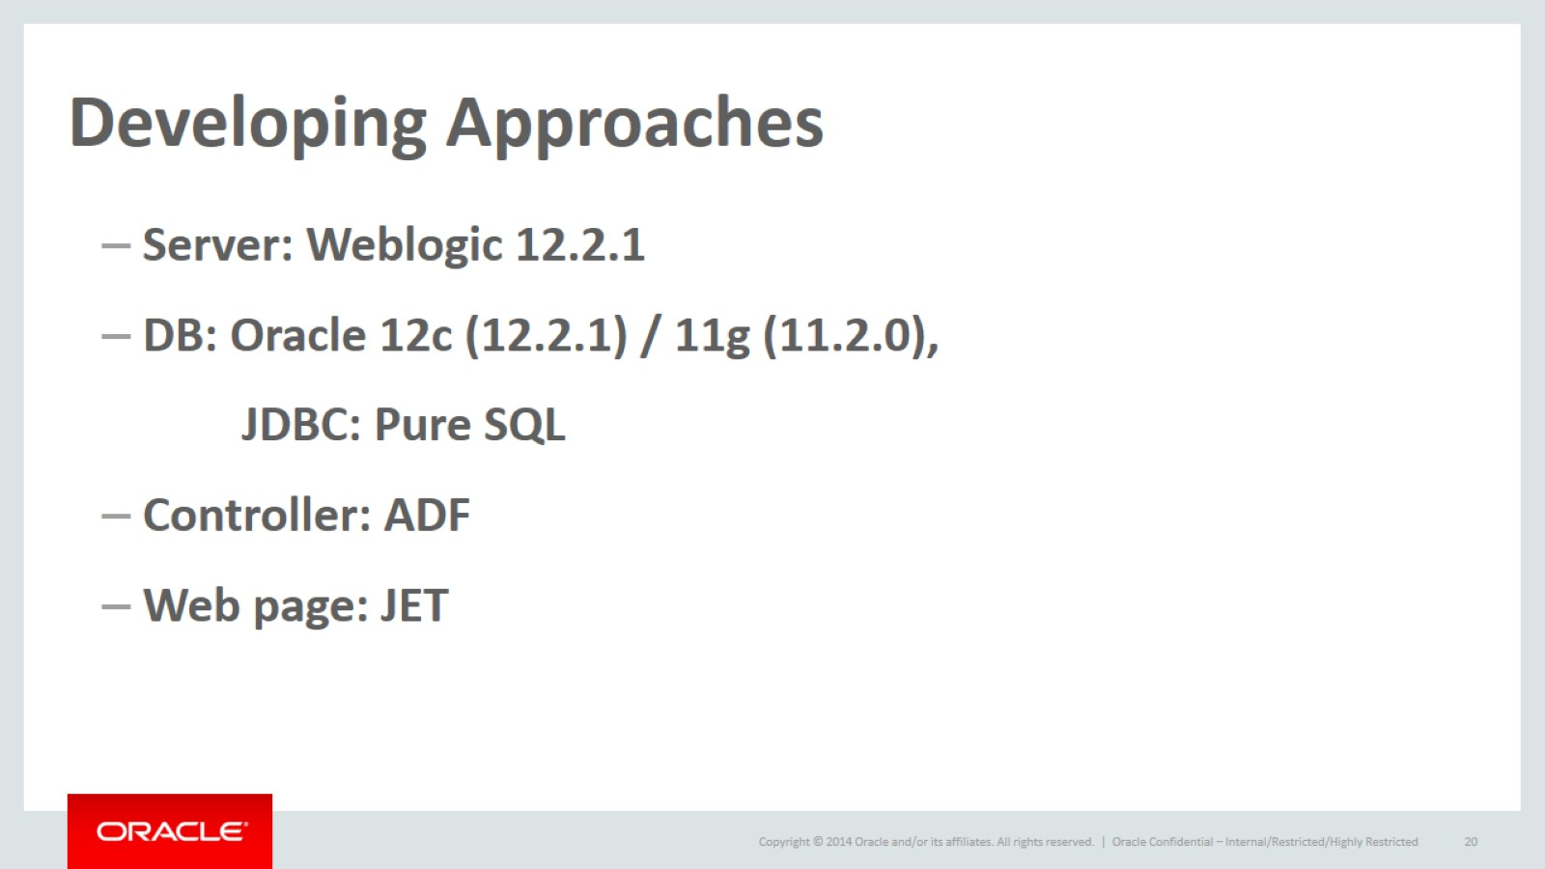
Developing Approaches

Slide 21

Functionality Demo

Slide 22
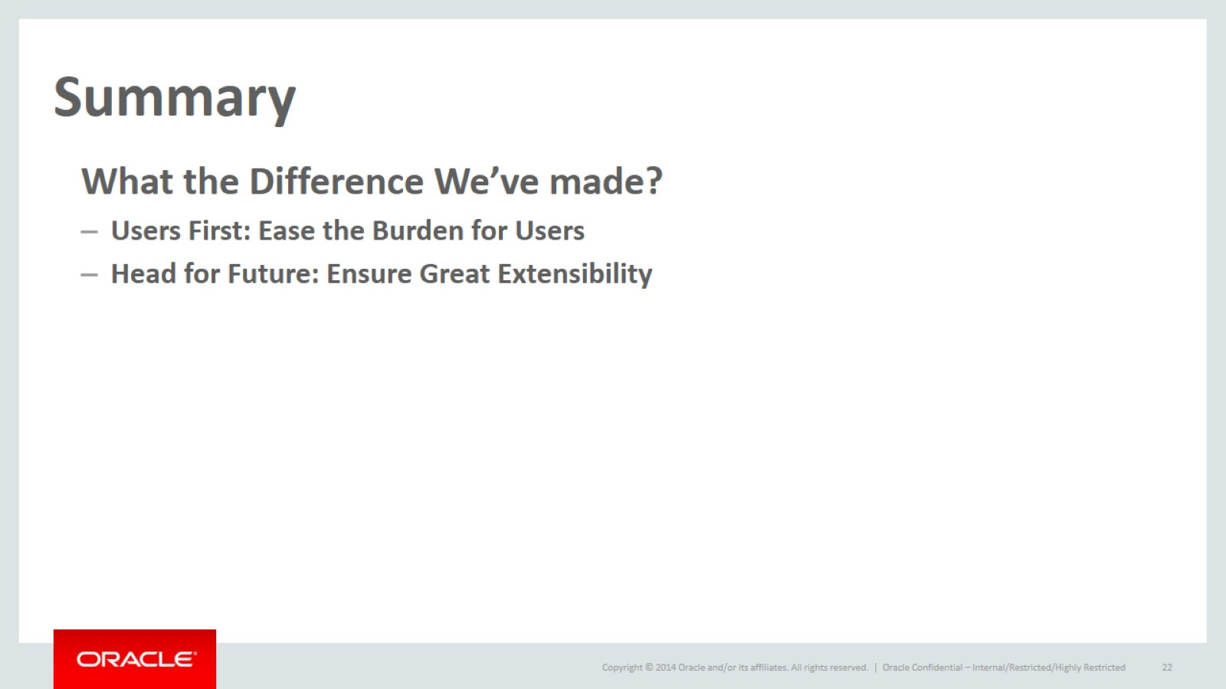
Summary

Slide 23
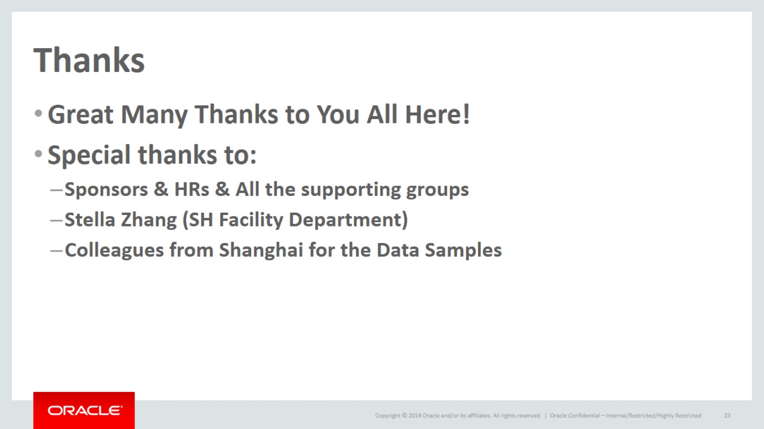
Thanks

Slide 24

Q & A

